Slide 1
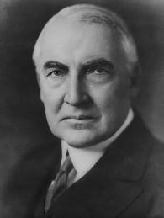
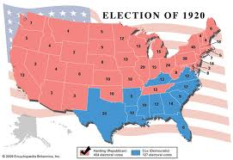
Chapter 12 Section 2
I. President Harding (1921)
His conservative stance on issues such as taxes, his campaign manager Harry Daugherty's 'make no enemies' strategy enabled Harding to become the compromise choice at the 1920 Republican National Convention.
During his presidential campaign, in the aftermath of World War I; he promised a return to "normalcy"; an "America first" campaign that encouraged industrialization and a strong economy independent of foreign influence.

Slide 2
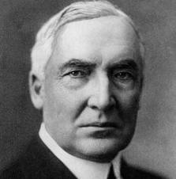
Chapter 12 Section 2
Harding, a fiscal conservative, represented a trend in government that departed from the progressive movement that had dominated Congress since President Theodore Roosevelt.
In the 1920 election, he and his running-mate, Calvin Coolidge, defeated Democrat and fellow Ohioan James M. Cox, in what was then the largest presidential popular vote landslide in American history since the popular vote tally began to be recorded in 1824: 60.36% to 34.19%.
Harding had calming words and his appearance calmed the nation, but he had bad judgement and his administration was plagued with scandals

Slide 3
Chapter 12 Section 2
Washington naval conference (Sec. of State) Evan Hughes proposed no new warships to be built by major powers for 10 years.
Nations agreed and signed Kellogg Briand Pact which proved to be futile
France and Britain – Borrowed $10 million from America
2 ways to pay back debt 1) Sell goods to U.S. 2) Collect reparations from Germany
Germany didn’t pay

Slide 4
Chapter 12 Section 2
- Fordney McCumber Tariff- Rose taxes on U.S. imports by 60% protecting U.S. businesses from Foreign competition.
The Fordney–McCumber Tariff of 1922 raised American tariffs in order to protect factories and farms.
Congress displayed a pro-business attitude in passing the tariff and in promoting foreign trade through providing huge loans to Europe, which in turn bought more American goods
This made it impossible for France and Britain to sell enough goods to U.S. to repay debts

Slide 5
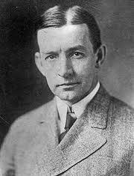
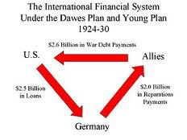
Chapter 12 Section 2
Since Germany didn’t pay, French marched in
An American named Dawes was sent to negotiate loan. Dawes Plan enacted
Dawes Plan-The Dawes Plan (as proposed by the Dawes Committee, chaired by Charles G. Dawes) was an attempt following World War I for the Triple Entente to collect war reparations debt from Germany. When after five years the plan proved to be unsuccessful, the Young Plan was adopted in 1929 to replace it. Main points of the Dawes Plan

Slide 6
Chapter 12 Section 2
In an agreement of August 1924, the main points of The Dawes Plan were:
1. The Ruhr area was to be evacuated by Allied occupation troops.
2. Reparation payments would begin at “one billion marks the first year, increasing to two and a half billion marks annually after five years" (Merrill 93)
3. The Reichsbank would be reorganized under Allied supervision.
4. The sources for the reparation money would include transportation, excise, and custom taxes.

Slide 7
Chapter 12 Section 2
The Dawes Plan did rely on money given to Germany by the US.
The German economic state was one in which careful footing was required, and the Dawes plan was of the nature that only with the unrelated help of loans from the US could it succeed.
The plan was accepted by Germany and the Triple Entente and went into effect in September 1924.
Although German business rebounded and reparation payments were made promptly, it became obvious that Germany could not continue those huge annual payments for long. As a result, the Young Plan was substituted in 1929.

Slide 8
Chapter 12 Section 2 Quiz
1.) What did Harding do for the nation that made people want to elect him?
a.) He had a calming influence
b.) He was very good at squashing scandals
c.) He had proven he had good judgment
2.) What type of judgment did many people believe Harding had?
a.) Good judgment
b.) Bad judgment
c.) Extraordinary judgment
3.) What was the Kellogg Briand Pact
a.) A pact that major powers would not built warships for 10 years.
b.) A pact that nobody would start war in the next 10 years.
c.) A Pact that brought the World together in an alliance
4.) Who was in debt to America?
a.) Russia and Germany
b.) Germany and France
c.) France and Britain
5.) Name one way France and Britain could pay back America?
a.) They could collect reparations from Germany
b.) They could declare war and defeat all of the U.S. enemies
c.) They could raise taxes on American imports
6.) Name one way France and Britain could pay back America?
a.) They could sell goods to the U.S.
b.) By borrowing money from U.S. enemies
c.) Raising taxes on American exports
7.) What Tariff made it tough for France and Britain to repay the U.S.
a.) Fordney McCumber Tariff
b.) Bank Loan Act
c.) Dawes Act Tariff
8.) What happened when Germany did not repay France?
a.) France asked that the U.S. step in
b.) The U.S. started to attack Germany
c.) France started to attack Germany
9.) What was a plan where the U.S. would loan money to Germany so they could pay back a.) France and Britain, and then France and Britain would pay back the U.S.
a.) WWII Plan
b.) Dawes Plan
c.) Retribution Plan
10.) What was Harding’s administration like?
a.) It was very smooth and peaceful
b.) It embraced foreign competition for U.S. businesses
c.) It was plagued with scandal and controversy

