Slide 1
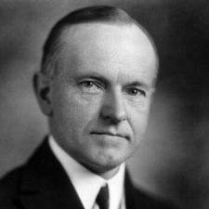
Chapter 12 Section 3
I. The Business of America
President Coolidge (1920’s) Fit into business spirit of 1920’s
Said “He who builds a factory builds a temple and the man that works there worships there”
Wanted to keep taxes down and business profits up, and supported giving business credit so they could expand
Wanted to keep government interference at a minimum with businesses
Placed high tariffs on foreign imports

Slide 2
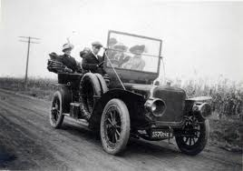
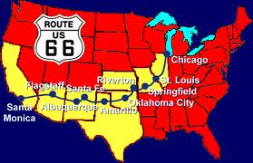
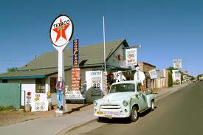
Chapter 12 Section 3
Automobile changed American landscape. Led to construction of paved roads. (Could drive in all weather) Route 66 could drive west from Chicago to California
Many settled in towns along the route
Houses now were built with garages or driveways
Gasoline stations, repair shops etc… sprung up

Slide 3
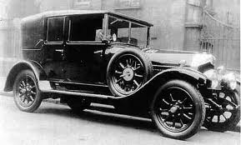
Chapter 12 Section 3
Rural families could now travel to the city
Urban Sprawl and it drew people to oil states
Status symbol (by late 1920’s around 80% of all vehicles were in U.S.
1 automobile for every 5 people

Slide 4
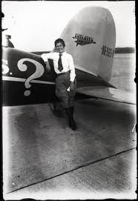
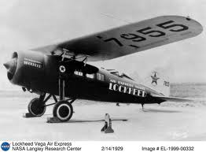
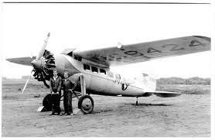
Chapter 12 Section
Trimotor plane made by Henry Ford in 1926
1927 Lockheed Company produced Vega which was a single engine plane
1927 Pan American Airways first transatlantic passenger flights

Slide 5
Chapter 12 Section 3
1920’s very prosperous, American’s owned around 40% of worlds wealth
Average income rose 35% in ‘20’s from $522 to $705
Gasoline powered much of the economy and electricity transformed the nation
Electricity was able to reach suburbs, but most farms still lacked power
Businesses searched for new ways to advertise (came up with slogans)
People believed prosperity would go on forever

Slide 6
Chapter 12 Section 3
Lots of mergers with companies, chain stores sprouted
Income gap between workers and management became larger and obvious
Farms suffered losses
Installment plans introduced through banks which allowed Americans to focus on present and not the future and threw caution to the wind
There was little warning of what was to come, which was the depression

Slide 7
Chapter 12 Section 3 Quiz
1.) Name one president during the 1920’s.
a.) Calvin Coolidge
b.) Ulysses S. Grant
c.) Abraham Lincoln
2.) Finish the quote “ He who builds a factory, builds a ______ ?
a.) House
b.) Palace
c.) Temple
3.) What did president Coolidge think about the government and business?
a.) He wanted a lot of government interference in business
b.) He did not want a lot of government interference in business
c.) He believed business and government go hand in hand
4.) What kind of tariffs were placed on foreign imports?
a.) High Tariffs
b.) Tariffs were not placed on foreign imports
c.) Low
5.) Name one invention that changed the American landscape during this period?
a.) Television
b.) Automobile
c.) Internet
6.) During the 1920’s, America was ____?
a.) Very prosperous
b.) Not doing very well
c.) Facing the fact it may become a third world country
7.) Name the famous route that was built that connected from Chicago to California?
a.) Route 44
b.) Route 33
c.) Route 66
8.) When was the first Transatlantic flight?
a.) 1927
b.) 1937
c.) 1907
9.) What product began to fuel the economy?
a.) Horse Saddles
b.) Gasoline
c,.) Television sales
10.) Name a new way in which Americans began to buy things?
a.) Through trade
b.) Through Credit and installment plans
c.) Writing checks

