Slide 1
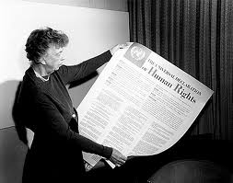
Chapter 15 Section 2
I. New Deal is popular with people
- People wanted 2nd New Deal
- Eleanor Roosevelt (FDR’s wife) pushed FDR to pass New Deal.

Slide 2
Chapter 15 Section 2
- Started by 1936 election that FDR won his 2nd term and got votes from African Americans and union leaders
- Resettlement Administration and FSA gave loans to farmers and provided over $1 billion in aide.
- WPA (Works Project Administration) created – Built Jelsma and Squires Field in 1936.
- Spent $1 billion and created 8 million jobs.
- Mostly unskilled workers that built 850 airports, 651,000 square miles of roads and streets and 125,000 public buildings.

Slide 3
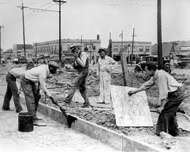
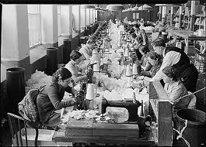
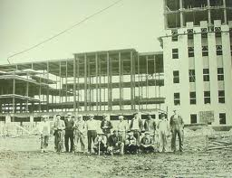
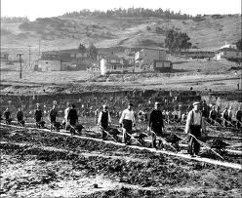
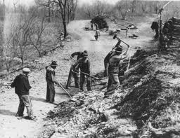
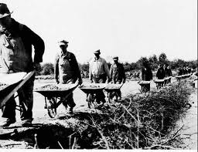
Chapter 15 Section 2
New Deal Workers

Slide 4
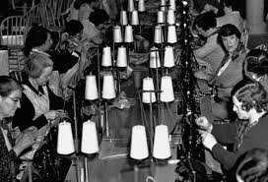
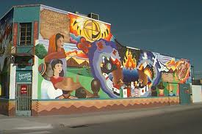
Chapter 15 Section 2
- Women workers given jobs
sewing clothes for needy.
- Gave working people a
sense of hope
- Professionals painted murals on buildings etc…
WPA helped women and
minorities
NYA (National Youth Admin.
provided education, jobs and
recreation for young

Slide 5
Chapter 15 Section 2
- Wagner Act – prohibited unfair labor practices (Set Minimum wage work hours in a week etc…
- Social Security Act – 1) Gave money to people over 65 2) Compensation to unemployed 3) Gave aide to families with dependent children or disabled kids.

Slide 6
Chapter 15 Section 2 Quiz
1.) What did the people think about the New Deal?
a.) They liked it
b.) They didn’t care one way or the other about it
c.) They did not like it
2.) Who pushed for the 2nd New Deal?
a.) Eleanor Roosevelt
b.) Theodore Roosevelt
c.) Herbert Hoover
3.) What program built Jelsma stadium and Squires Field?
a.) YMCA
b.) WPA
c.) PWA
4.) How much money was spent creating jobs?
a.) 1 billion
b.) 1 Million
c.) 8 billion
5.) What was most of the workers in the 2nd New Deal skill level?
a.) Somewhat skilled
b.) Highly skilled
c.) Unskilled
6.) How many airports were built by WPA crews?
a.) 85
b.) 8
c.) 850
7.) How many square miles of road were built by WPA crews?
a.) 651,000
b.) 65,000
c.) 651
8.) How many public buildings were built by WPA crews?
a.) 125,000
b.) 125
c.) 12,500
9.) What type of jobs did the WPA give women?
a.) Sewing clothes for needy
b.) Building buildings
c.) High Management Jobs
10.) What organization provided education, jobs and recreation for the youth?
a.) YMCA
b.) NYA
c.) NYPD

Slide 7
Chapter 15 Section 2
11.) What act prohibited unfair labor practices?
a.) The Labor Act of 1932
b.) Foraker Act
c.) Wagner Act
12.) Name one thing the Social Security Act did?
a.) Provided jobs for people over 65
b.) Provided medical insurance for people over 65
c.) Provided money for people over 65
13.) Name one thing the Social Security Act did?
a.) It provided jobs for people over 65
b.) It provided compensation for people who were unemployed
c.) It gave aide to businesses who gave unemployed people jobs
14.) Name one thing the Social Security Act did?
a.) It provided an amendment to the Articles
b.) It provided compensation for war veterans
c.) It gave aide to families with dependent or disabled children
15.) The New Deal was created in response to what major event?
a.) World War 1
b.) The Great Depression
c.) The Civil War

