Slide 1
CHAPTER 16
WORLD WAR LOOMS
1931 – 1941

Slide 2
Failures of the World War I Peace Settlement
Treaty of Versailles cause anger & resentment in Europe
Germany resents blame for the war, the loss of colonies & border territories
Russia resents loss of lands used to create other nations
New democracies flounder under social and economic problems
Dictators rise, driven by nationalism and desire for more territory

Slide 3
Characteristics of a Totalitarian State
Dictatorship exerting control over all aspects of life
Strong, charismatic leader often at head of government
State control of the economy
Use of police, spies, & terror to enforce the will of the state
Government control of the media and use of propaganda to indoctrinate citizens
Use of schools and youth organizations to speed ideology to children
Strict censorship of artists, intellectuals and political rivals with dissenting opinions

Slide 4
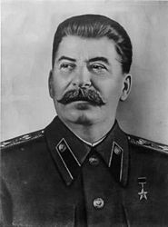
Joseph Stalin transforms the Soviet Union
1924, Joseph Stalin takes over
  replaces private farms with collectives
  purges anyone who threatens his power; 8 to 13 million killed
  hurts the command in the Russian Army

Slide 5
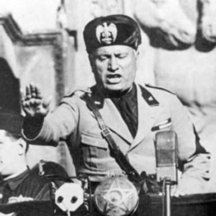
The Rise of Fascism in Italy
He established the Fascist Party in 1921, known as the Black Shirts
1922, the Italian king appointed him head of government
  Called himself Il Duce or “The Chief”

Slide 6
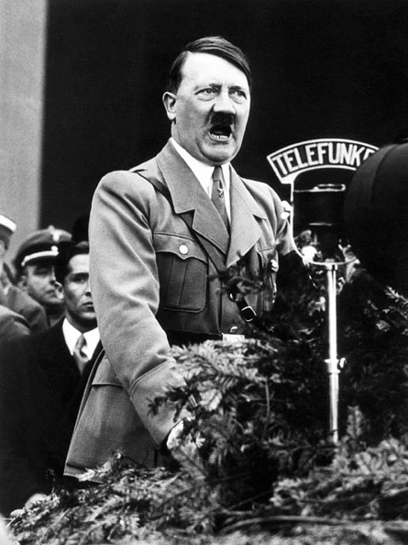
The Nazis Take Over Germany
Adolf Hitler became the leader of National Socialist Workers’ Party in 1919
While in prison, he wrote Mein Kampf, “My Struggle”
  basic beliefs of Nazism, based on extreme nationalism and racism

Slide 7
Adolf Hitler
By 1932, 6 million unemployed; many men join Hitler’s private army (Brown Shirts)
Nazis become the strongest political party in Germany
  Hitler named chancellor (Prime Minister) in 1933
He dismantles the democratic Weimar Republic
  Established the Third Reich, Third German Empire (Thousand Year Reich)

Slide 8
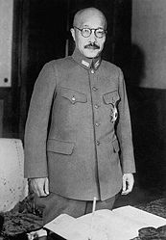
Militarists Gain Control in Japan
1931, Nationalist military leaders seize Manchuria
League of Nations condemns action; Japan quits the League
Militarists take control of Japanese government
  1941, General Tojo becomes prime minister

Slide 9
Aggression in Europe and Africa
1933, Hitler quits League; 1935 he begins a military buildup
1936, Hitler sends troops into Rhineland, League does nothing to stop him
1935, League fails to stop Mussolini’s invasion of Ethiopia

Slide 10
Americans Cling to Isolationism
Americans become isolationist and FDR backs away from foreign policy
1935, 1936, & 1937 Neutrality Acts try to keep U.S. out of future wars
  outlaws arms sales and loans to nations at war
  ban arm sales and loans to nations undergoing a civil war

Slide 11
Neutrality Breaks Down
1937 Japan launches new attacks on China
FDR sends aid to China
  1941 American Volunteer Group (AVG) aka Flying Tigers
  100 pilots and crews volunteer to help the Chinese Air Force
1939 Neutrality Act included a Cash and Carry provision
  Nations paid cash for weapons & ship them on their own ships

Slide 12
Chapter 16 Section 1 Quiz
6.) What did Stalin do to people who did not agree with his communistic views?
a.) He Killed them
b.) He appreciated everybody’s view points to make his country better
c.) They were protected by their first amendment rights
7.) What does it mean when a government is totalitarian?
a.) The people are ruled under democratic views
b.) The government has complete control of its people
c.) The government is for the people and by the people
8.) What is a belief that power should go to a few party leaders?
a.) Democracy
b.) Capitalist
c.) Fascism
9.) What happens in a Fascist society?
a.) The interest of the state outweighs the interest of the individual
b.) The interest of the individual outweighs the interest of the state
c.) Interest are equal between the state and individual
10.) What type of beliefs did German leader Adolph Hitler have?
a.) Nazism
b.) Federalism
c.) Capitalism
1.) What kind of leaders did post World War 1 bring?
a.) Powerful
b.) Mostly democratic
c.) Weak
2.) What is it called when a person is driven by a loyalty to one’s country above all else?
a.) Capitalism
b.) Nativism
c.) Nationalism
3.) What was happening to most democracies?
a.) They were failing
b.) They were dwindling in number
c.) They were doing very well
4.) What type of government took over in Russia?
a.) Communism
b.) Democracy
c.) Federalism
5.) What happens to possession under a Communist government?
a.) The government owns most things
b.) Individual ownership becomes very important
c.) The Business sector owns most things

Slide 13
Chapter 16 Section 1 Quiz con’t.
11.) What is nationalism?
a.) a belief that your country is better than all others
b.) a belief that all countries should be considered equal
c.) a belief that your country is inferior
12.) What was the master race according to Nazism?
a.) The white race
b.) The African American race
c.) The Native American race
13.) Name one type of person that was picked out by the Nazi’s as being inferior?
a.) Jews
b.) Germans
c.) Communists
14.) Name one type of person that was picked out by the Nazi’s as being inferior?
a.) German Americans
b.) Native Americans
c.) African Americans
15.) What did most people in Hitler’s army have in common?
a.) Hitler had given them great jobs
b.) They were unemployed prior to entering his army
c.) They were prominent citizens in society prior to joining his army

