Slide 1
CHAPTER 17
WAR IN EUROPE
THE UNITED STATES in
WORLD WAR II
1941 – 1945

Slide 2
Mobilizing for Defense
After Pearl Harbor, 5 million men volunteer for military service
10 million more drafted to meet needs of a two-front war
1942, Gen. George Marshall, Army Chief of Staff, calls for a women’s corp.
  Women in noncombat positions

Slide 3
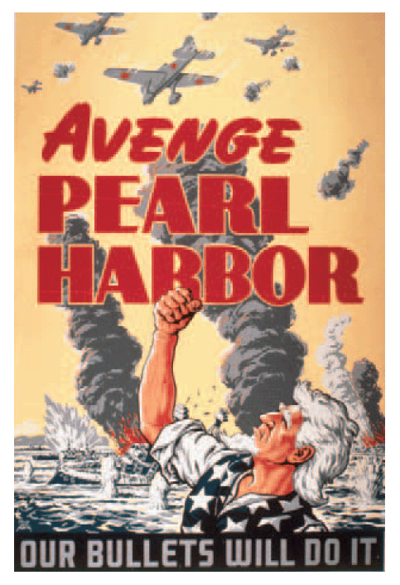
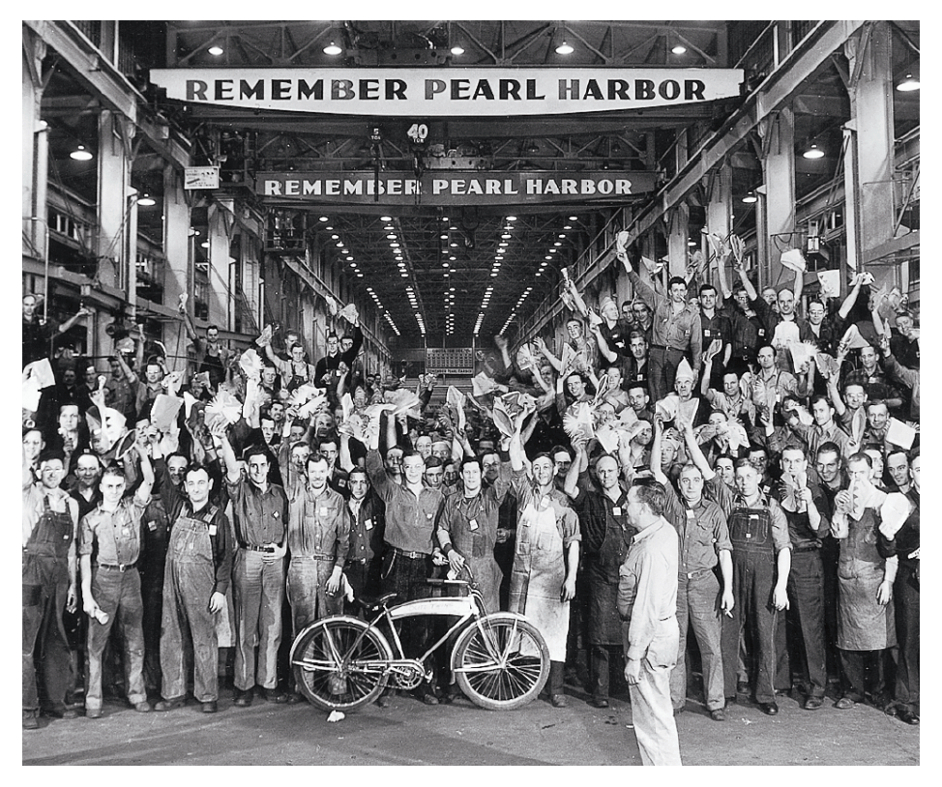
Mobilizing for Defense

Slide 4
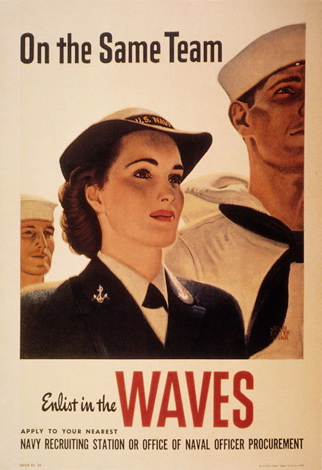
Mobilizing for Defense cont.
May 15, Women’s Auxiliary Army Corps (WAAC) is started
WAVES for the Navy
  13,000 women applied on the first day
  250,000 women will serve during the war

Slide 5
Dramatic Contributions
300,000 Mexican Americans join the armed forces
1 million African American serve; they live and work in segregated units
13,000 Chinese Americans and 33,000 Japanese Americans serve
25,000 Native Americans enlist (800 were women)

Slide 6
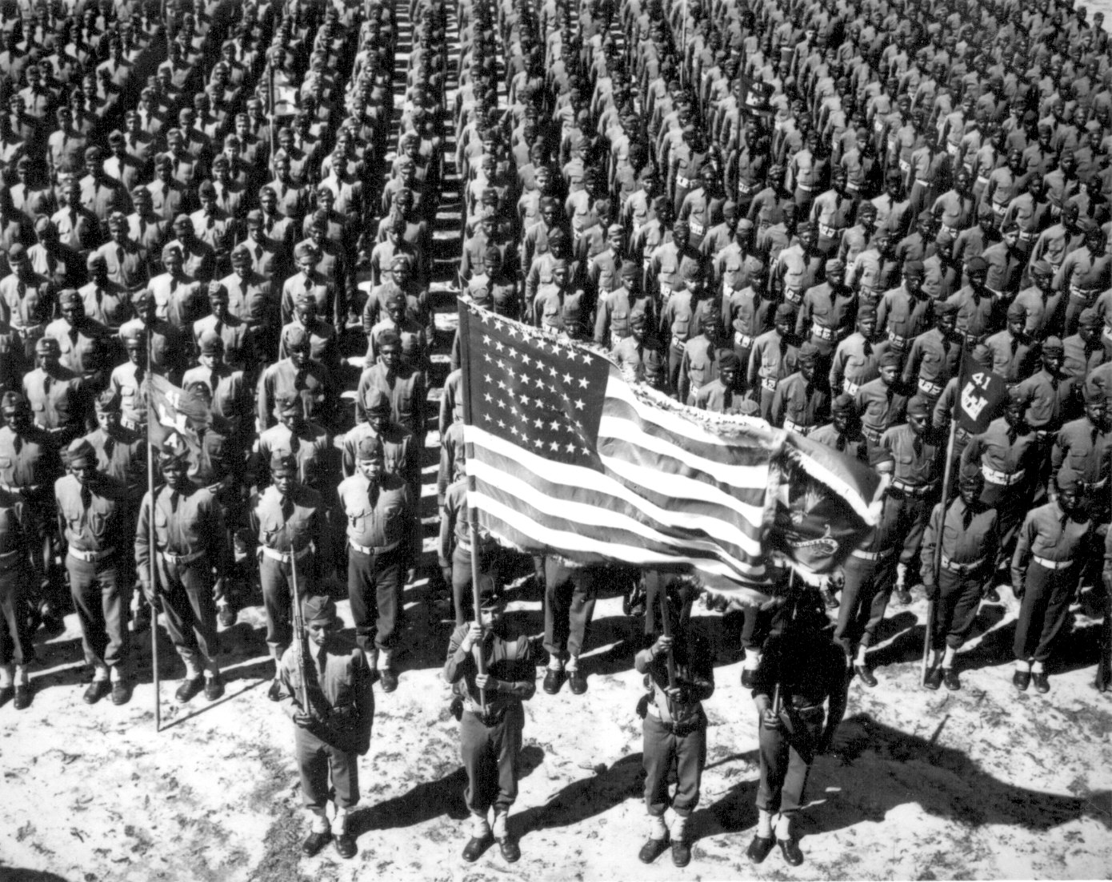
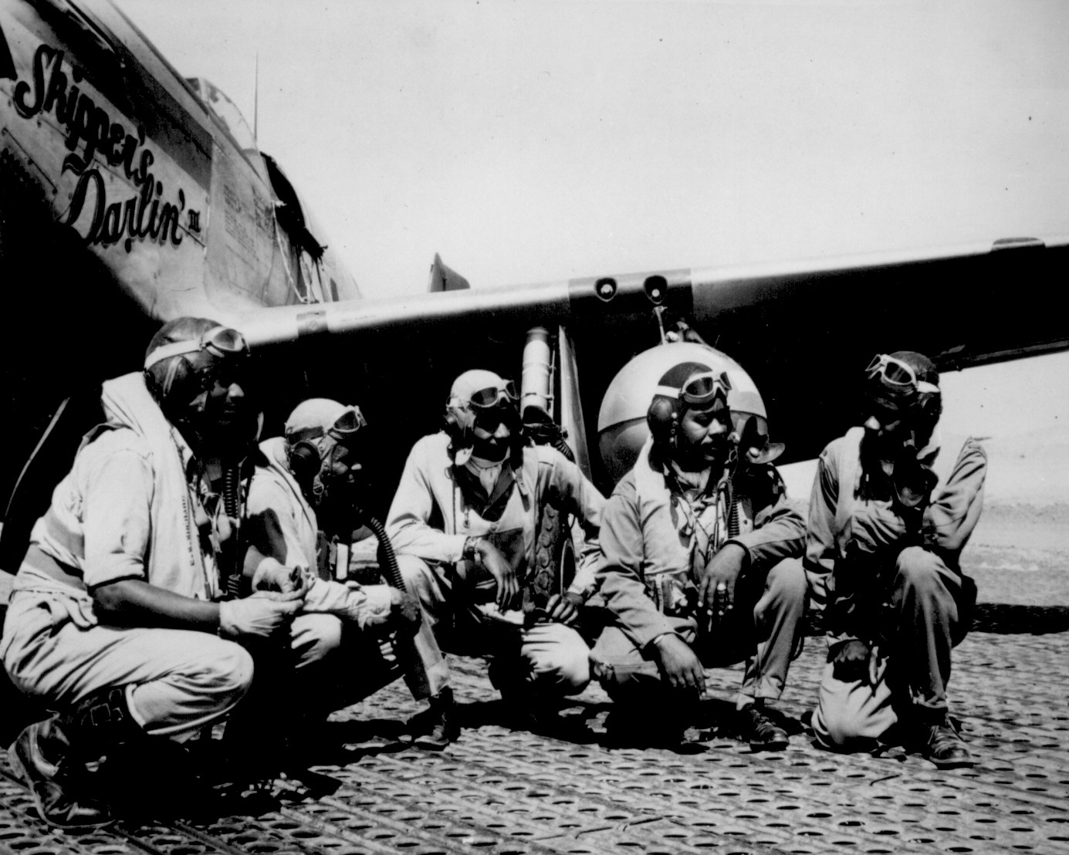
Dramatic Contributions

Slide 7
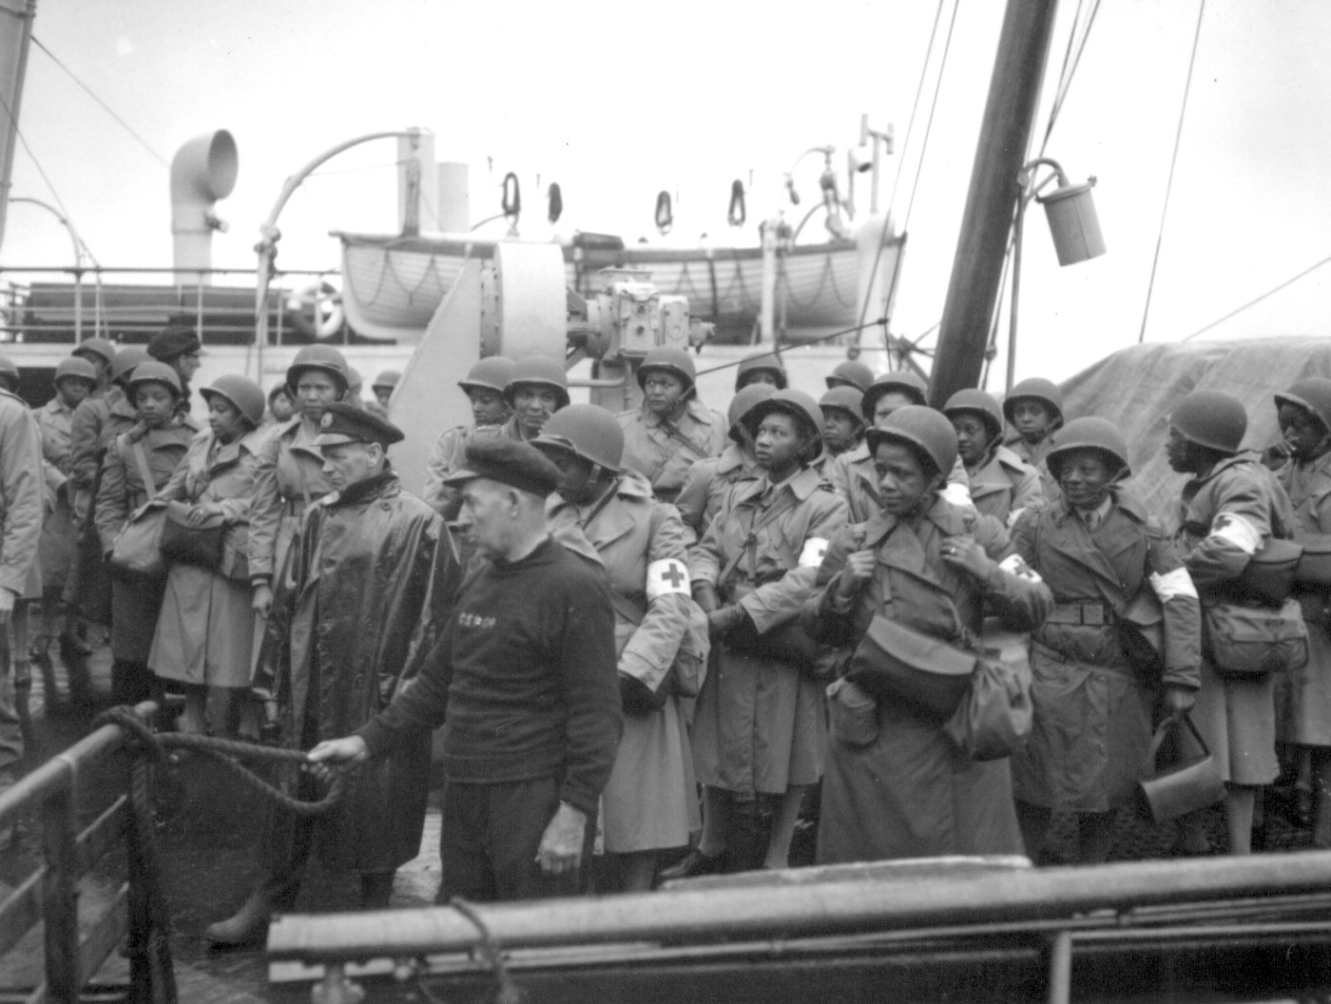
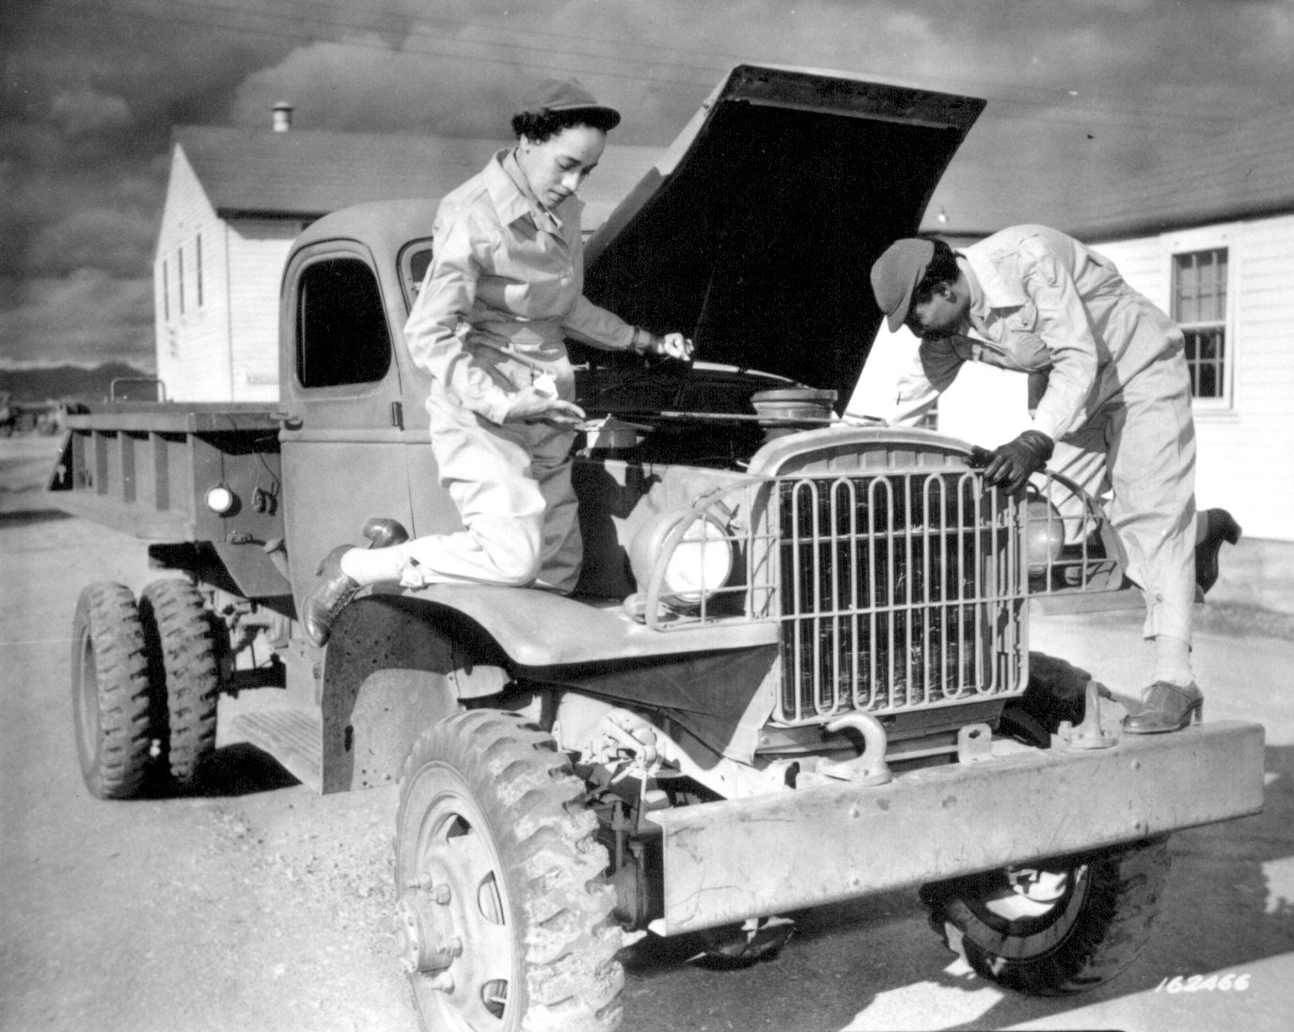
Dramatic Contributions

Slide 8
The Industrial Response
1942, The last car rolled off the assembly line
Factories were converted from civilian to war production
Defense planets expanded, new ones built
  jeeps were built in downtown OKC
  planes, bombers, were built at Tinker AFB

Slide 9
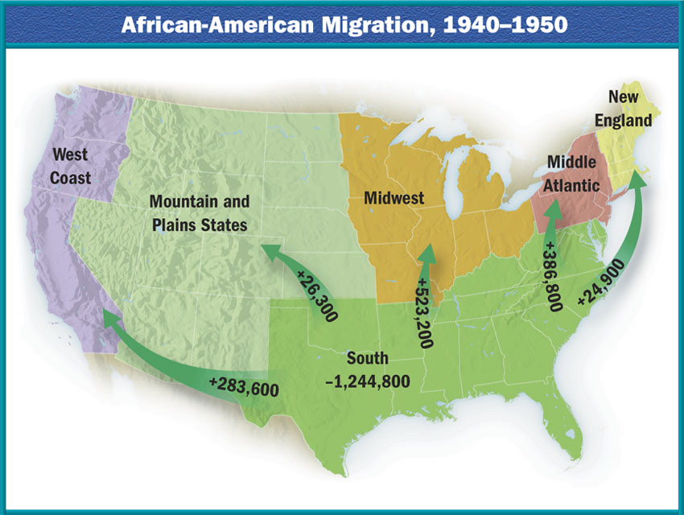
The Industrial Response

Slide 10
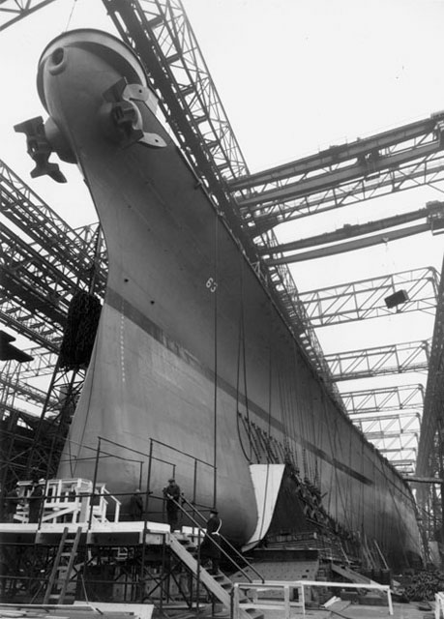
The Industrial Response cont.
Shipyards and factories produce arms rapidly
  people work 24 hrs, 7 days a week
  Liberty ships could be built in 4 days

Slide 11
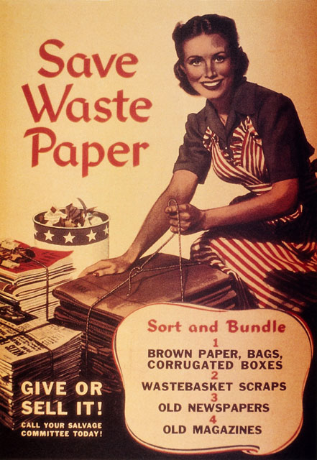
Economic Controls
Office of Price Administration (OPA) freezes prices and fights inflation
War Production Board (WPB) says which companies will convert to war production
  allocates raw materials, (steel, oil, rubber)
  organizes collections of recyclable materials

Slide 12
Chapter 17 Section 1 Quiz
1.) What port did Japan attack?
a.) Hiroshima
b.) Port of Boston
c.) Pearl Harbor
2.) What did Japan think America would do after they bombed Pearl Harbor?
a.) They thought America would back down
b.) They thought America would fight back
c.) They thought America would be forced to remain neutral
3.) What were young Americans attitudes like towards the military?
a.) They were eager to join the military
b.) They were indifferent to joining the military
c.) They were not eager to join the military
4.) How long was basic training?
a.) 1 month
b.) 1 year
c.) 8 weeks
5.) What corp. allowed women to serve in the military?
a.) Women’s Military Rights corp.
b.) Women’s Auxiliary corp.
c.) Civilian Conservation Corp.
6.) What types of duties were women assigned?
a.) Combat duties
b.) Upper management duties
c.) Non-Combat duties
7.) What were minority’s views of the war?
a.) They felt the need to fight to earn their citizenship
b.) They did not feel like it was their war and did not want to figh
c.) They did not have feelings towards the war either way
8.) What happened to automobile plants?
a.) They began to shut down
b.) They started making planes, tanks and boats
c.) They continued making and selling more domestic vehicles than ever
9.) What were many factories converted to?
a.) Basic training quarters for military people to live in
b.) Homeless shelters for war veterans
c.) War production plants
10.) How many workers worked in war production plants?
a.) 18 Million
b.) 18,000
c.) A little over a thousand

Slide 13
Chapter 17 Section 1 Quiz 1 Con’t.
11.) Name one thing that World War II did for women?
a.) It gave them more opportunities at work in factories
b.) It sent them into combat for the first time
c.) It sent women to the front line for the first time
12.) What percentage of men’s wages did women get?
a.) 60%
b.) 80%
c.) 100%
13.) How many minorities worked in factories during World War II?
a.) More than 2 million
b.) Less than 1 million
c.) Around 100,000
14.) Before World War II, what percentage of factories refused to hire African
Americans?
a.) 50%
b.) 85%
c.) 100%
15.) What did the OSRD bring to the war?
a.) Scientific discoveries that helped America win the war
b.) Food rationing based on science
c.) Psychological counseling for the women who were on the front line
16.) Name one big OSRD invention that helped America in World War II?
a.) Telescopes and Satellites
b.) Mass media techniques of getting information back to American public
c.) Radar and Sonar
17.) Name one big OSRD invention that helped America in World War II?
a.) Atomic Bomb
b.) Telescopes and Satellites
c.) Better uniforms for the troops
18.) What medicinal invention by the OSRD saved many lives in World War II?
a.) Aspirin
b.) Penicillin
c.) Cold Medicine
19.) What was Pres. Roosevelt worried might happen to the American Economy?
a.) Inflation due to their being more war time demand than supply
b.) Lack of money for the war
c.) We would run out of resources for the Military
20.) What office was created to fight off inflation?
a.) Office of Inflation prices
b.) Food and Drug Administration
c.) Office of Price Administration

Slide 14
Chapter 17 Section 1 Quiz con’t.
21.) What project was founded to research the atomic bomb?
a.) The Philadelphia Project
b.) The Holocaust Project
c.) The Manhattan Project
22.) What Board was created to ensure that the military had all the supplies it needed?
a.) Military Supplies Board
b.) The Food and Drug Administration Board
c.) War Production Board
23.) What was one thing the WPB asked of U.S. Citizens?
a.) That they rationed food
b.) That they join the military
c.) That they ration their use of water
24.) What was one thing the WPB asked of U.S. Citizens?
a.) That they rationed gas
b.) That they join the military
c.) That they ration their spending
25.) What was the market called when people bought good illegally?
a.) The Black Market
b.) The Stock Market
c.) The Stolen and Illegal Market

