Slide 1
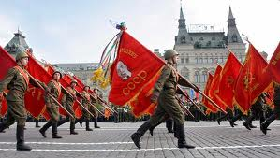
Chapter 18 Section 1
The wartime alliance between the United States and the Soviet Union began to unravel even before the end of World War II.
When the war ended, the Red Army occupied much of Eastern Europe. The evident weakness of Western Europe raised the specter of communism spreading even further.

Slide 2
Chapter 18 Section 1
Although the Marshall Plan helped restore Western Europe, other events of the late 1940s kept tension high: the Communist coup in Czechoslovakia and Soviet blockade of West Berlin in 1948, the fall of China and the Soviet A-bomb in 1949.
Soviet support for the North Korean invasion of South Korea in 1950 confirmed the threat in Western eyes.

Slide 3
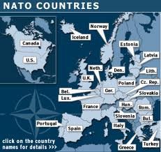
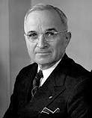
Chapter 18 Section 1
The establishment in 1949 of the Western alliance, NATO (North Atlantic Treaty Organization), and the 1955 Warsaw Pact between the Soviet Union and its satellites solidified the two opposing blocs that shaped the Cold War.
World relies on United Nations and Truman becomes president when Roosevelt died. Truman did not know many of the inside things going on in the government, and many Americans doubted his ability to do the job as president.

Slide 4
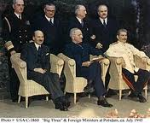
Chapter 18 Section 1
Truman tried for diplomacy in Potsdam Conference- The Potsdam Conference was held at Cecilienhof, the home of Crown Prince Wilhelm Hohenzollern, in Potsdam, Germany, from July 16 to August 2, 1945.
The participants were the Soviet Union, the United Kingdom, and the United States.
The three nations were represented by Communist Party General Secretary Joseph Stalin, Prime Minister Winston Churchill and later Clement Attlee, and President Harry S Truman.

Slide 5
Chapter 18 Section 1
Stalin, Churchill, and Truman—as well as Attlee, had gathered to decide how to administer the defeated Nazi Germany, which had agreed to unconditional surrender nine weeks earlier, on May 8 (V-E Day).
Roosevelt promised that he would allow free elections in Eastern Europe but Stalin refused to allow this in Poland. This put U.S. and Russia in deep odds.

Slide 6
Chapter 18 Section 1
Bargaining at Potsdam-At Yalta Stalin wanted reparations from Germany to help pay for war, and Truman objected to that.
After bargaining it was agreed that the Soviets, British, Americans, and French would take reparations mainly from their own occupation zones.
Truman also wanted to spread democracy and free trade across the world, as U.S. industry boomed during the war making the U.S. the economic leader in the world.
Soviets were also a major power, but, unlike the U.S. it had seen devastation on its own soil, and this is why they wanted reparation.

Slide 7
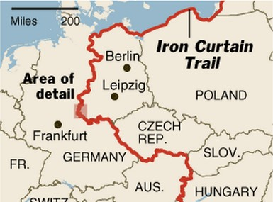
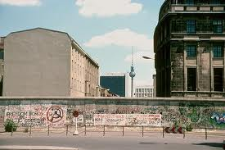
Chapter 18 Section 1
Truman decides to enact a policy of containment on Soviets, meaning taking measures to prevent any extension of communist rule to other countries.
This divided Europe into two political regions: 1)Western Europe-Democratic
2) Eastern Europe- Communist
The phrase Iron Curtain came to stand for the division of Europe.

Slide 8
Chapter 18 Section 1
The Truman Doctrine is a set of principles of U.S. foreign policy declared by President Harry S. Truman in an address to Congress to request $400 million in aid to Greece and Turkey, as well as authorization to send American economic and military advisers to the two countries.
Truman argued that the U.S. should support Greece and Turkey economically and militarily to prevent their falling under Soviet control. He supported this request by proclaiming: "One of the primary objectives of the foreign policy of the United States is the creation of conditions in which we and other nations will be able to work out a way of life free from coercion.
Truman called upon the U.S. to "support free peoples who are resisting attempted subjugation by armed minorities or by outside pressures. The Soviet Union was clearly at the heart of Truman's thoughts, but the nation was never directly mentioned in his speech. As Edler states, Truman was attempting to solve Eastern Europe's instability while making sure the spread of communism would not affect nations like Greece and Turkey.

Slide 9
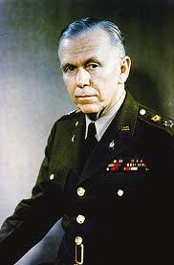
Chapter 18 Section 1
The Truman Doctrine represented the hard side of containment policy, while the Marshall Plan constituted the soft side.
The Marshall Plan was the primary plan of the United States for rebuilding and creating a stronger foundation for the countries of Western Europe, and repelling communism after World War II.
The initiative was named for Secretary of State George Marshall and was largely the creation of State Department officials, especially William L. Clayton and George F. Kennan.

Slide 10
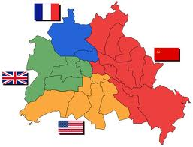
Chapter 18 Section 1
As Europe began to get
back on its feet the U.S.
and its allies clashed with the
Soviet Union over German
reunification.
At the end of the war Germany was divided into four zones occupied by U.S., Great Britain, and France in the West and the Soviet Union in the East.
1n 1948 Britain, and France and the U.S. decided to combine their 3 zones into one nation. The Western part of Berlin, was surrounded by Soviet occupied territory.

Slide 11
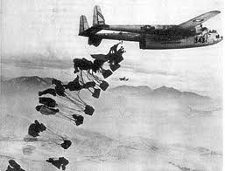
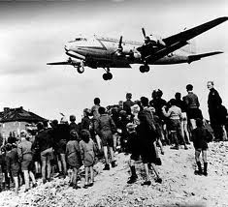
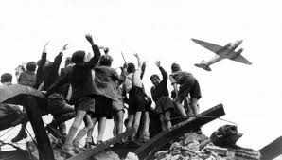
Chapter 18 Section 1
In 1948 Britain, and France and the U.S. decided to combine their 3 zones into one nation. The Western part of Berlin, was surrounded by Soviet occupied territory.
This created a dire situation, and in an attempt to break the blockade, American and British officials started the Berlin airlift to fly food and supplies into Western Berlin.
Berlin Airlift- For 327 days, planes took off and land every few minutes, around the clock. West Berlin survived because of this airlift, and it boosted American prestige around the world.

Slide 12
Chapter 18 Section 1
In the same month West Germany became a new nation, called West Germany and the Soviets created East Germany.
The Berlin blockade increased Western European fear of Soviet agression.
As a result 10 Western European Nations joined with the U.S. and Canada to create a military alliance called NATO.
The 12 members pledged to support each other in case any member was attacked.

Slide 13
Chapter 18 Section1 Quiz
1.) When did the wartime alliance between the U.S. and Russia begin unraveling?
a.) Before the end of WWII
b.) After WWII
c.) Before WWII
2.) What part of Europe was communist?
a.) Central Europe
b.) Western Europe
c.) Eastern Europe
3.) What part of Korea was communist?
a.) North
b.) South
c.) East
4.) What pact shaped the Cold War?
a.) The anti communist pact
b.) The Cold War Pact
c.) The Warsaw Pact
5.) What does NATO stand for?
a.) North Atlantic Treaty Organization
b.) North African Treaty Organization
c.) North American Treaty Organization
6.) What president took over for Roosevelt?
a.) Hoover
b.) Eisenhower
c.) Truman
7.) Describe Truman’s tactics on the war?
a.) He immediately declared war
b.) He tried to make Germany pay back Russia for the damage they had caused
c.) He tried for diplomacy
8.) What issue put the U.S. and Russia at deep odds with each other?
a.) Russia was not going to allow free elections in Poland
b.) The U.S. was not going to allow free elections in Poland
c.) The U.S. wanted Germany to pay reparations for WWII
9.) What was the U.S. afraid of?
a.) That Russia was more powerful than the U.S.
b.) That Poland was going to become the world’s only super power
c.) That communism was going to spread
10.) Who was the economic leader in the world at this time?
a.) The U.S.
b.) Russia
c.) Germany

Slide 14
Chapter 18 Section 1 Quiz Con’t.
11.) What was Truman’s policy of containment?
a.) It took measures to make sure every country kept to itself, even in trade
b.) It took measures to make sure that communism did not spread
c.) It took measures to make sure that Democracy would not spread to E. Europe
12.) What was a set of principles of U.S. foreign policy that requested $400 million
dollars to Greece and Turkey?
a.) The Truman Aid package
b.) The Truman Doctrine
c.) The Allied Recovery package
13.) Why did the U.S. want to give this aid to Greece and Turkey?
a.) They were trying to make them super powers to form an alliance
b.) The U.S. wanted to take over those countries
c.) They were trying to keep them from coming under communist rule
14.) Name the plan of the U.S. meant to create a stronger foundation for Western Europe?
a.) The Marshall Plan
b.) The Red Scare
c.) The Truman Doctrine
15.) What plan offered aid to Russia?
a.) The Axis Power relief plan
b.) The Marshall Plan
c.) The Reconstruction Plan
16.) What did Russia think about the Reconstruction plan?
a.) They rejected it
b.) They accepted it
c.) They were indifferent to it
17.) Which countries economies in the following list did not improve after WWII?
a.) Germany
b.) United States
c.) Russia
18.) How many zones was Germany broke into by the end of the war?
a.) 4
b.) 2
c.) 3
19.) What part of Berlin, Germany did the U.S. try to help?
a.) Western
b.) Eastern
c.) Central
20.) Why did most Western European states join with the U.S. and Canada?
a.) They did not want to be communist
b.) They wanted to be communist
c.) They felt sympathy for the Nazi’s who had been devastated in WWII

Slide 15
Chapter 18 Section 1 Quiz
11.) What were the set of principles of U.S. foreign policy that gave $400 million in aid to
Greece and Turkey?
a.) Truman Doctrine
b.) Roosevelt Doctrine
c.) Allies Recovery Doctrine
12.) Why did the U.S. want to support Turkey and Greece?
a.) To keep them from going to war with Germany
b.) To keep them from becoming communist
c.) To help them become a superpower
13.) What was the primary plan for repelling communism in Western Europe?
a.) The Dillon Plan
b.) The Red Scare Plan
c.) The Marshall Plan
14.) What plan offered aid to Russia and its allies?
a.) The Reconstruction Plan
b.) The Communist Aid Plan
c.) The Russian Aid Plan
15.) Did Russia accept or reject the Reconstruction Plan?
a.) Accept
b.) Reject
c.) Didn’t care either way
16.) Which European economy was not doing better than before the war?
a.) Russia
b.) France
c.) Germany
17.) How many zones was Germany broke into after the war?
a.) Two
b.) Four
c.) Three
18.) What part of Berlin did America send aid to?
a.) Eastern
b.) Western
c.) Central
19.) Name the Axis Powers
________________________________________
20.) What two nations was Germany broke into?
a.) East and West Germany
b.) North and South Germany
c.) North and West Germany

